Slide 1

TinyP2P
A Decentralized User-Friendly
Peer-to-Peer File-Sharing System
Nicky Reid
Supervisor: Yusuf Motara

Slide 2
File Sharing and Searching
Two components in a file sharing system:
  Lookup mechanism
  File download

Slide 3
Challenges to Uptake
Availability
Freeloaders
Legal issues

Slide 4
Challenge 1: Availability
In centralized or client/server architectures
Sharing can't take place if server unavailable
BitTorrent: can not torrent if Tracker is unavailable
To combat this: DHT, PeX and Magnet Links

Slide 5
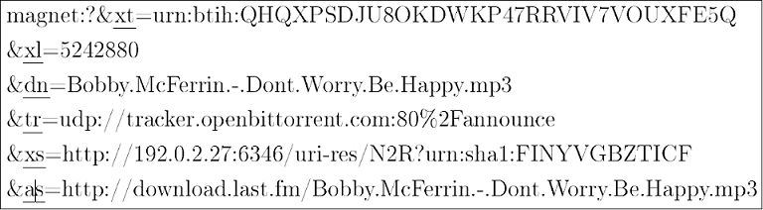
Magnet Links
Get download information directly from peers
List of parameters with download information

Slide 6
Challenge 2: Freeloading
Or “Leeching,” users don't contribute to file base
BitTorrent addresses this by giving seeders higher download speeds than leechers
Incentive to seed, but not a disincentive to use the system
Load balancing nature of DHT decreases detriment caused by freeloaders

Slide 7
Challenge 3: Legal issues
Copyright violation and piracy can lead to a disparity in the interests of the server host and the user
  EG: DC made unavailable at Rhodes
Detection of illegal traffic allows ISPs (including Universities) to block/throttle

Slide 8
Peer-2-Peer
Decentralized
All participants have client and server and router code
All participants can issue and serve requests and perform routing
Allows for random ports, and so traffic is difficult to detect

Slide 9
Distributed Hash Tables
Most scalable and robust P2P architecture
Partitions a hash table over many nodes
Storage and overhead are distributed among peers so it is highly scalable and load-balancing
Fast lookups

Slide 10
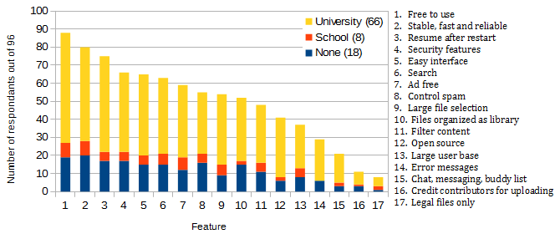
Usability Survey

Slide 11
TinyP2P
TinyP2P creates ad-hoc friend-to-friend file networks using a Distributed Hash Table
Purely decentralized – only depends on participating peers
Network is created when needed and dies after all participants have left
No installation needed
Runs on JVM, so only requires Java Runtime Environment
Less than 6.5MB in size and can be run from a flash or external hard drive

Slide 12
IP Mnemonics
IP Addresses are used to connect peers
Mnemonics map a four word phrase to an IP address
Simplistic way of abstracting IP address to make them easier to relay
  127.0.0.1 → “lab zip zip ace”
  192.168.123.213 → “lol out key sip”
  48.92.14.78 → “die had bad fox”

Slide 13
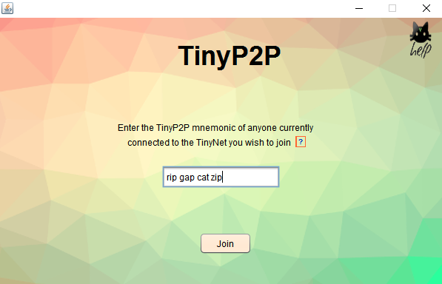
Joining a TinyNet with an IP Mnemonic

Slide 14
Features
TinyP2P facilitates:
  Directory browsing
  Downloading files
  Sending files
  Chat

Slide 15
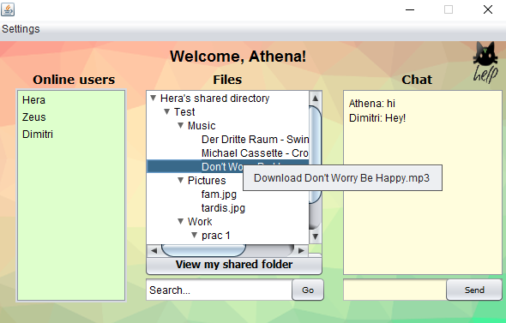
Main Window

Slide 16
Decentralization to overcome challenges: Availability
DHT: No requirement for central server to facilitate peer connection and file searching
Peers need an IP of any connected peer to join
IP Mnemonics are a short string shared to facilitate connection.
Highly simplistic, but mimic Magnet Links

Slide 17
Decentralization to overcome challenges: Freeloading
In a DHT, all participating peers assist in the routing of messages and maintenance of the hash table
Even peers who don't share anything
Scalability means that freeloaders don't have a significantly detrimental effect.

Slide 18
Decentralization to overcome challenges: Legal issues
No reliance on a host → no host/client interest disparity
Difficult to shut down externally
P2P traffic difficult to detect

Slide 19


